Slide 1

Reporting Portal User Guide – Manager User
©️ 2023 by OrgVitality, LLC. All rights reserved under the U.S. laws and international treaties, including the Berne Convention. No part of this work may be reproduced, distributed, republished or used without the expressed written consent of author.

Slide 2
Slide 3: Initial Log-in View
Slide 4: Main Menu
Slide 5: Overview of Tour
Slide 6: Overview Results Explorer – Select Report to View
Slide 7: Overview Results Explorer – Overview
Slide 8: Overview Results Explorer – Dimensions
Slide 9: Overview Results Explorer – Questions
Slide 10: Overview Results Explorer – Heatmap
Slide 11: Overview Results Explorer – Comments
Slide 12: Report Library
Slide 13:Help and Resources
Table of Contents
©️ 2023 OrgVitality

Slide 3
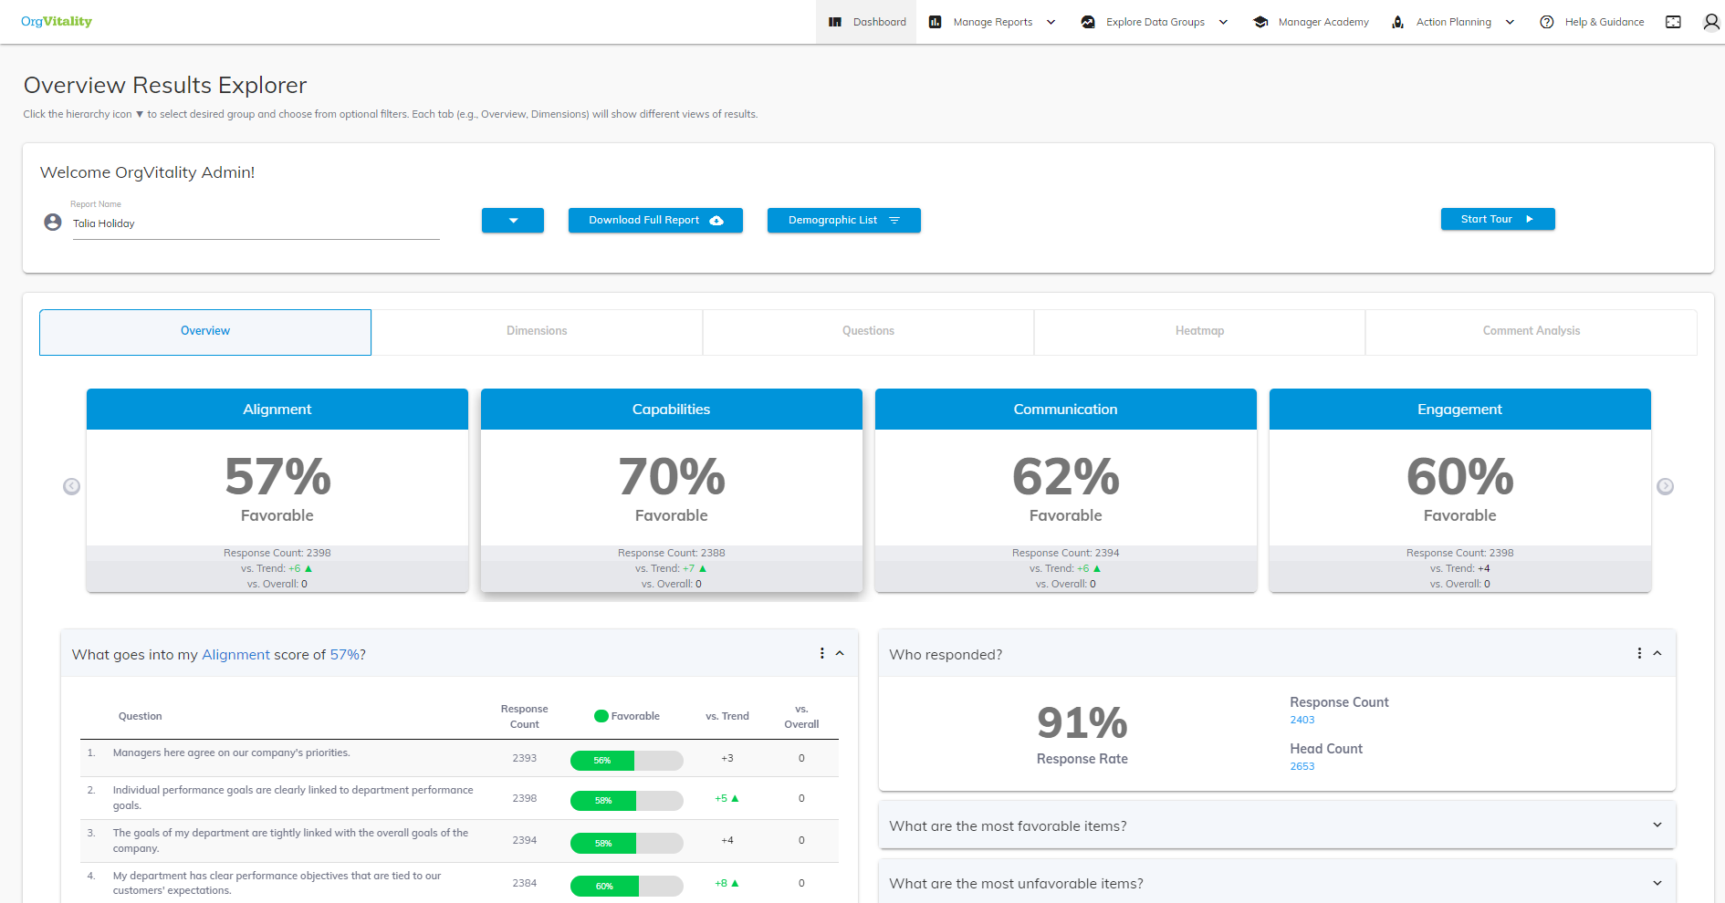
Initial log-in view

Slide 4


Main Menu
Overview of Results
Dimensions
Questions
Heatmap
Comment Analysis
Dashboard
Report Library (Pre-Generated Reports)
Manage Reports

Slide 5
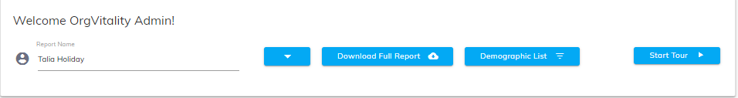
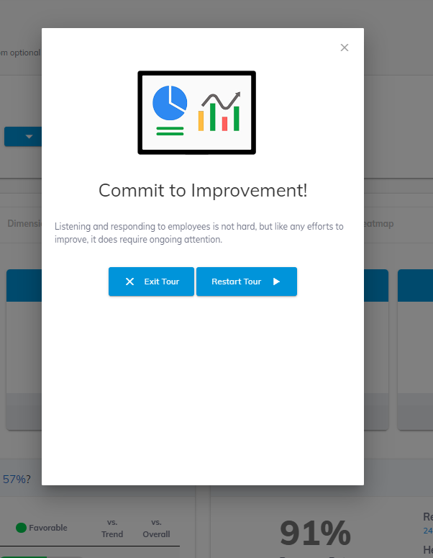
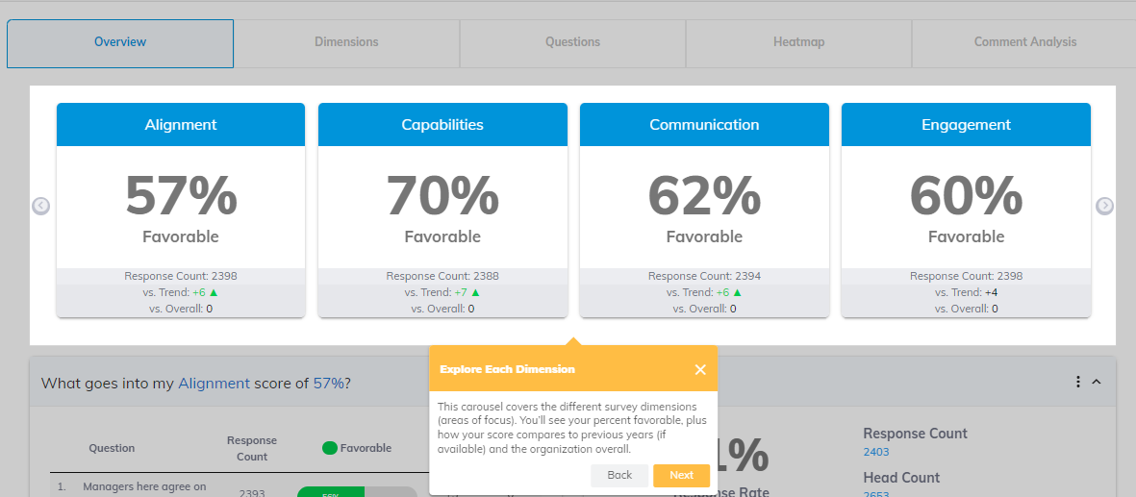
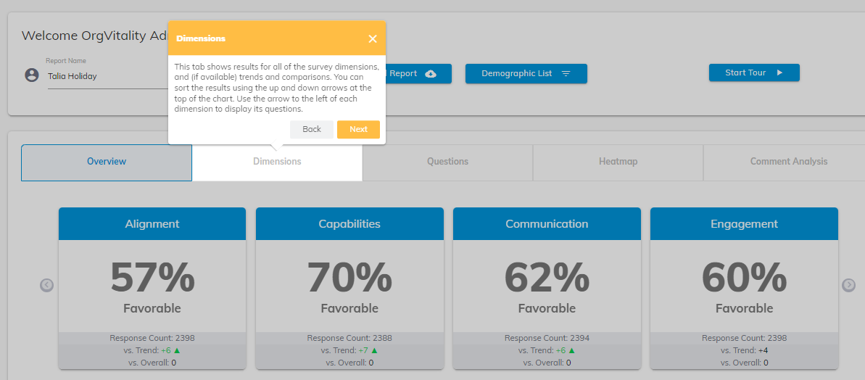
Overview Tour
When you first log into the portal a pop-up will appear to take a “tour “of the portal. You can exit out of the tour at any point and re-start the tour by clicking the ‘Start Tour’ button.
Once the tour has started click ‘Next’ to progress or ‘Exit’ to stop the tour.

Slide 6

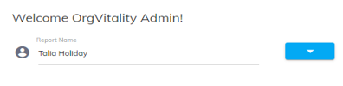
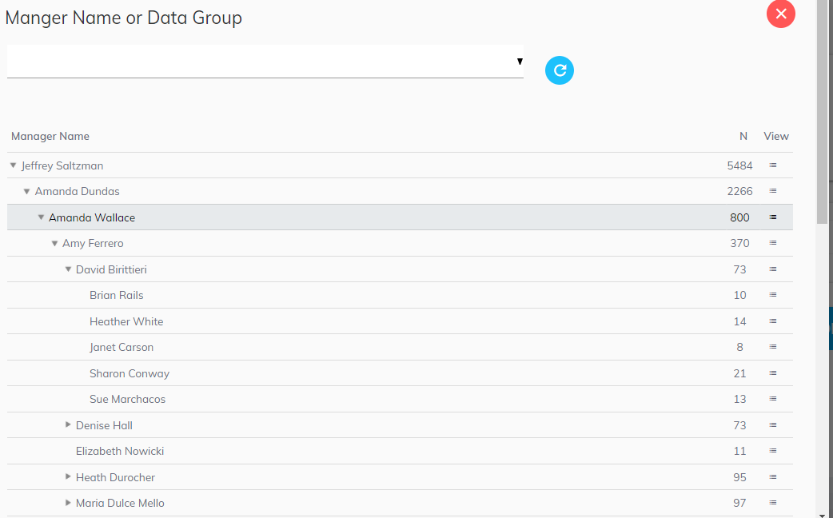
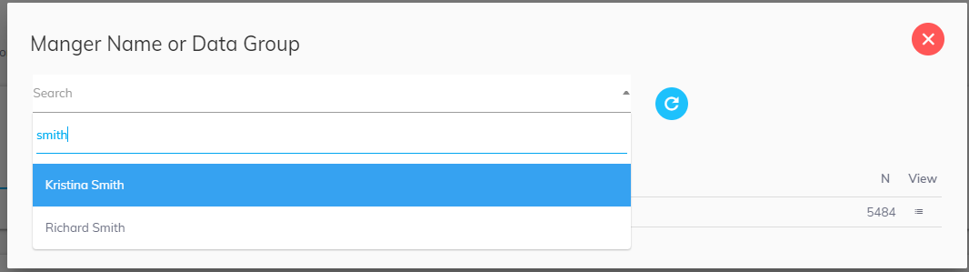
Dashboard- Select Reports to Review
Click on the blue dropdown arrow to:
Type name (or partial name) of a report in the search bar* or
Select name from the dropdown*
Expand hierarchically by clicking on the arrow on the left
Select manager by clicking on the hamburger icon on the right in the “view” column
1
2
*Note: You will have access only to your own group and any managers that report to you (if they qualified for a report)

Slide 7
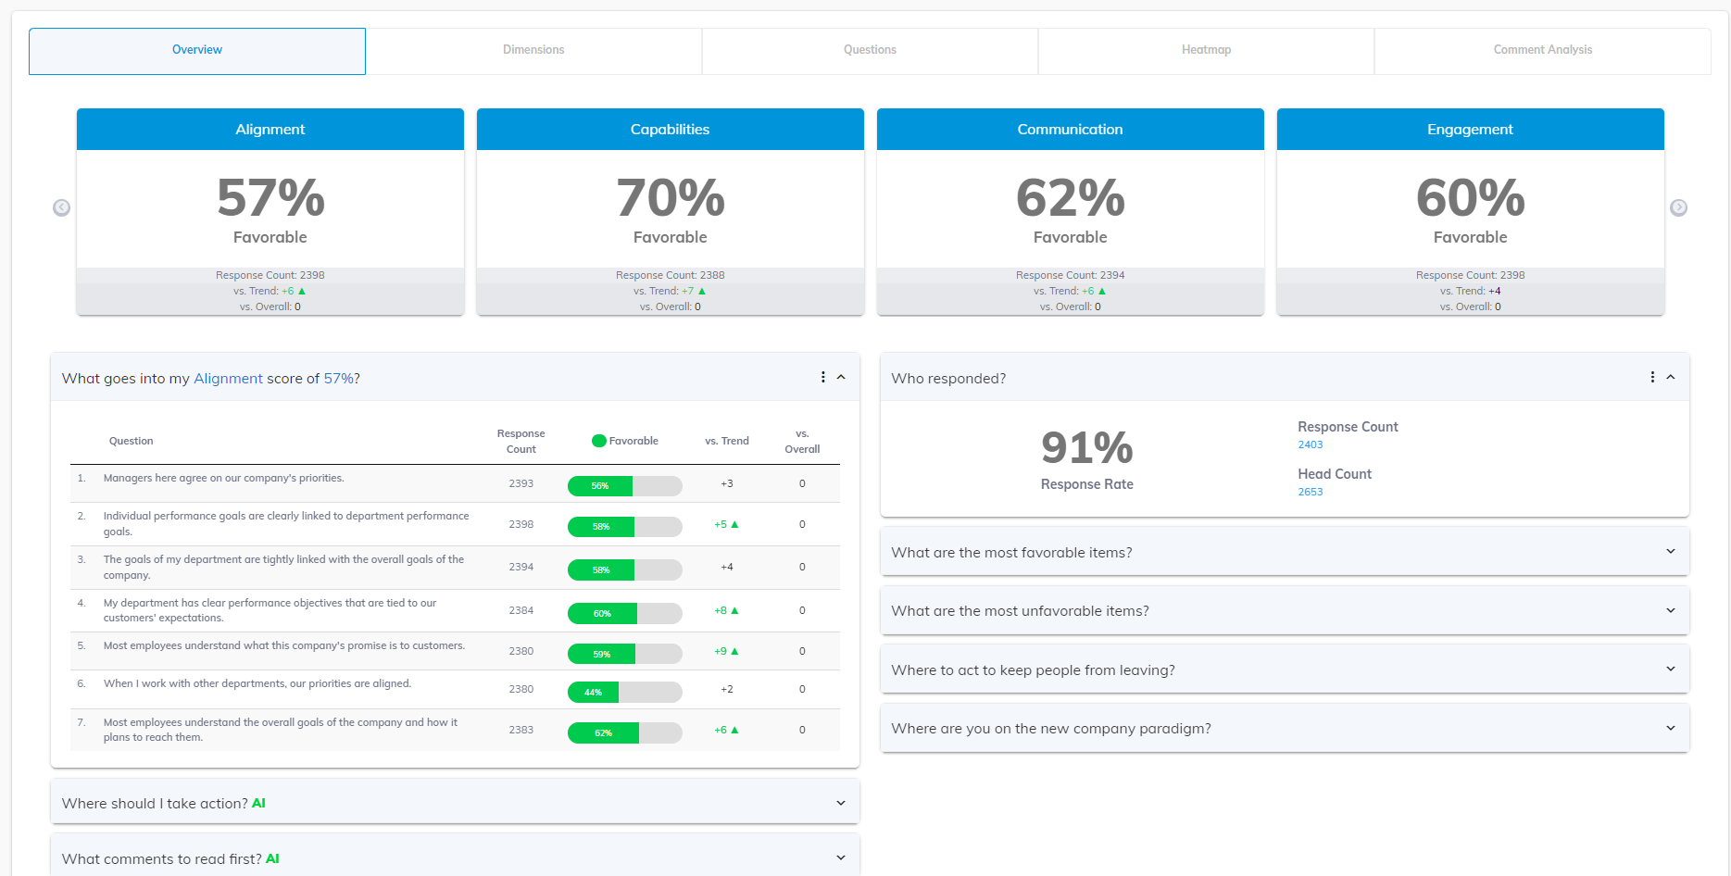
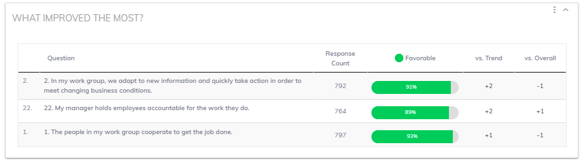
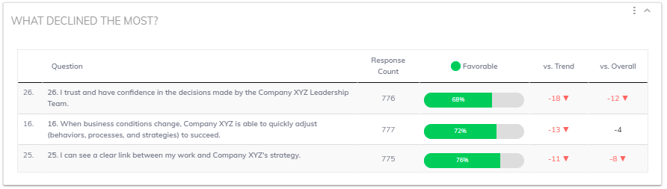
In this tab you can view a broad overview of results. View dimension scores and their related items, as well as other available analyses like Most Favorable and Most Unfavorable items, Action Priorities, Most Improved and Most Declined items (based on trend).
Note: Click on the top right three vertical dots in any module to download an Excel version or take a screenshot.
Dashboard- Overview
This carousel covers the different survey dimensions (areas of focus). You’ll see your percent favorable, plus how your score compares to previous years (if available) and the organization overall.
Dimension Details
Click or to
cycle through all dimensions.
Clicking on a dimension in the carousel above will open the items for each dimension.
Click on the ∨ arrow to see the details for each module.
Our Action Prioritization algorithm identifies three items that, if acted upon, will have the greatest impact. These items were chosen by analyzing your results and taking organizational strategies into account and focus on issues where you will be able to create real change.

Slide 8
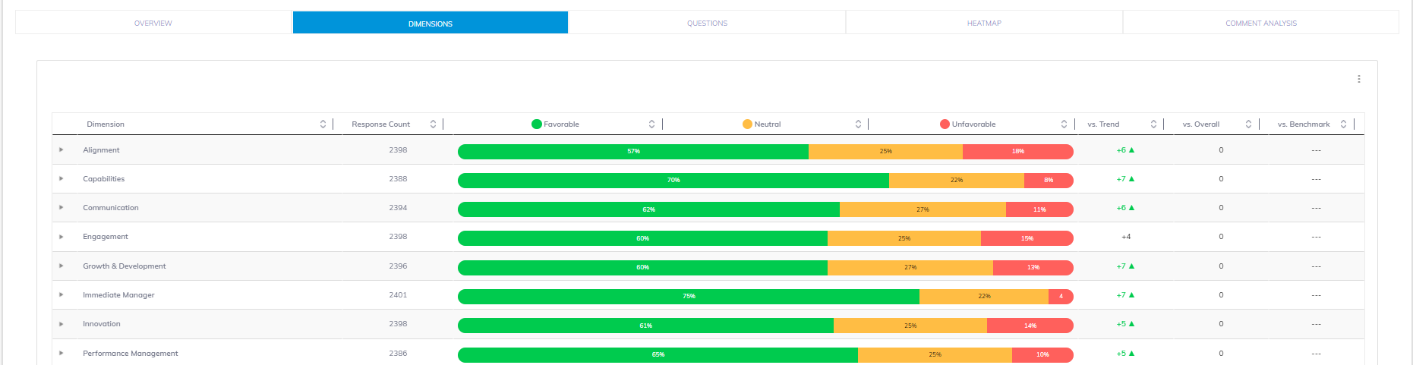
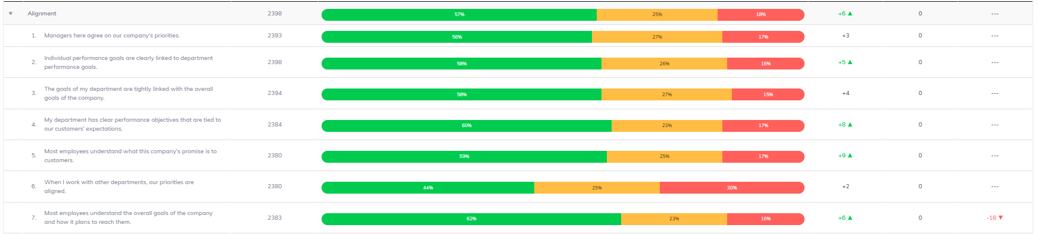
Dashboard- Dimensions
In this tab you can view all dimension results.
This tab shows results for all survey dimensions, and (if available) trends and comparisons. You can sort the results using the up and down arrows at the top of the chart. Use the arrow to the left of each dimension to display its questions.
Note: Click on the top right three vertical dots in any module to download an Excel version or take a screenshot.
Click on the arrow to view the results for each survey question within each dimension.

Slide 9
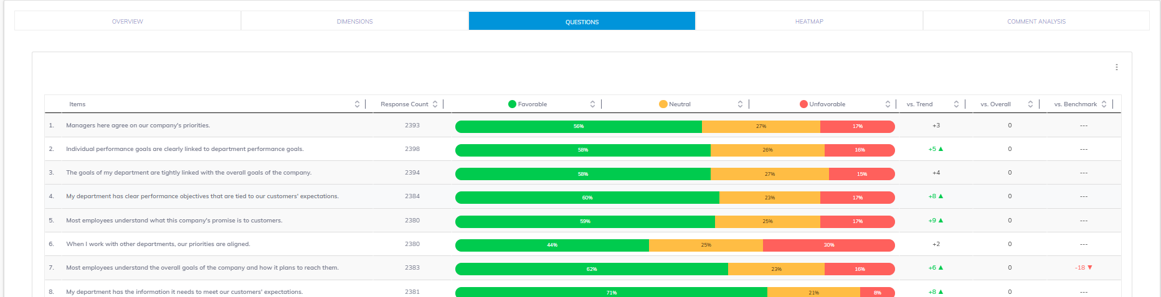
Dashboard- Questions
In this tab you can view all question results.
This tab shows results for all the survey questions, and (if available) trends and comparisons. You can sort the results using the up and down arrows at the top of the chart.
Note: Click on the top right three vertical dots in any module to download an Excel version or take a screenshot.

Slide 10
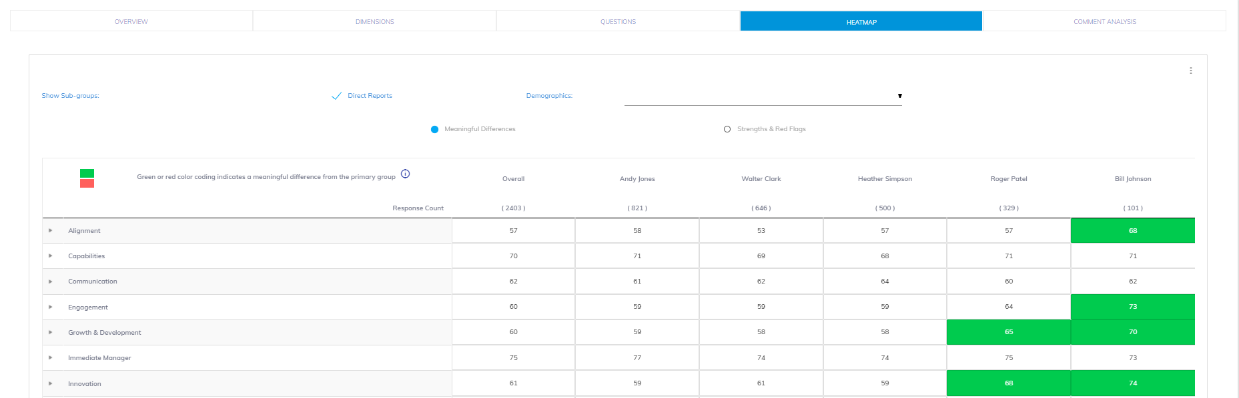
Dashboard- Heatmap
In this tab you can view all dimension & question results.
The Heatmap shows the main group and subgroup results side by side. Shading represents meaningful differences OR Strengths & Red Flags.
Note: Click on the top right three vertical dots in any module to download an Excel version or take a screenshot.
Choose shading preference for the heatmap by clicking the button.
Click on the arrow to view the results for each survey question within each dimension.

Slide 11
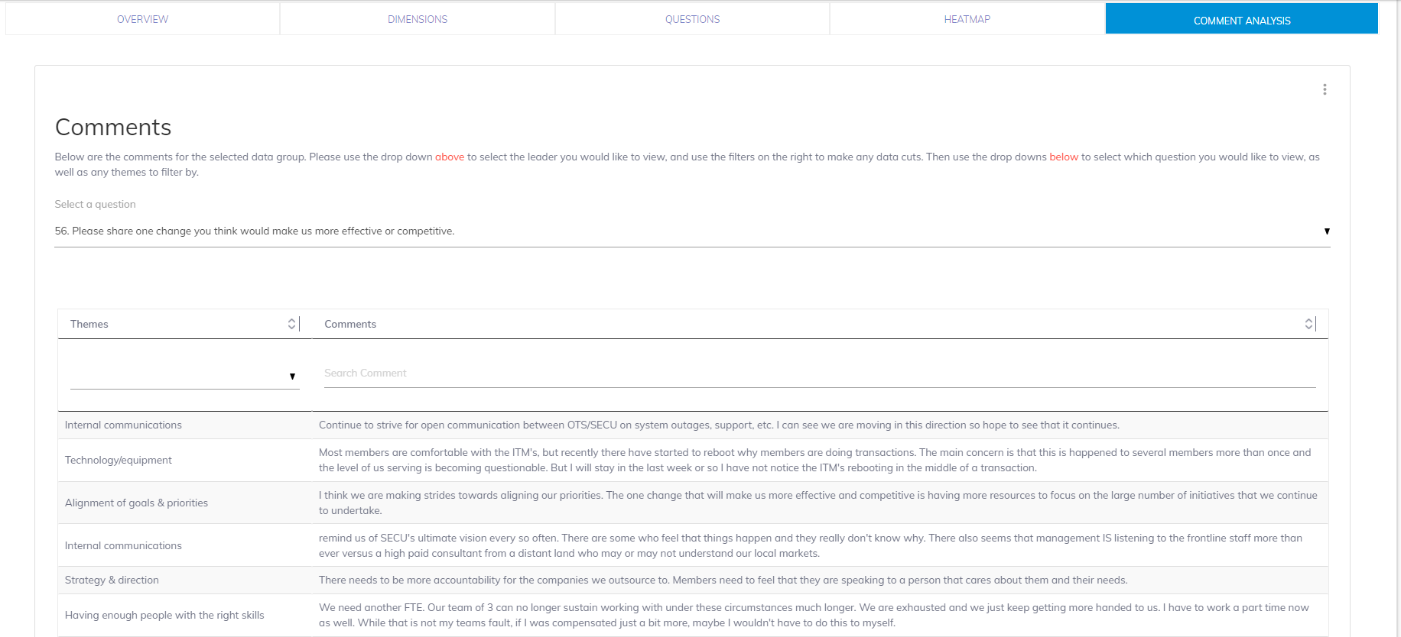
Dashboard- Comments
In this tab you can view all comments and themes.
This tab shows responses to the open-ended survey items. Use the dropdown list to select a question. Comments can also be exported to Excel.
Note: Click on the top right three vertical dots in any module to download an Excel version.
Use the dropdown to view the open-ended questions and responses.
Search for comments here.
For questions that allowed for self selected themes use the dropdown to filter by theme.

Slide 12
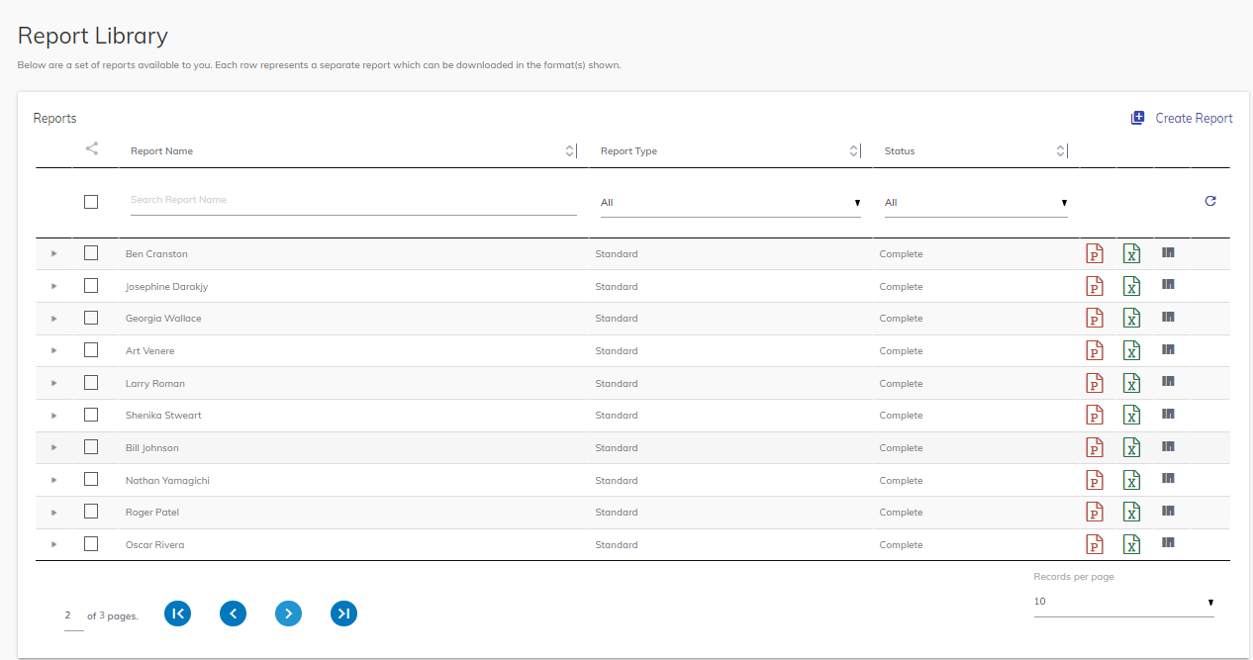
Manage Reports- Report Library
In the Report Library you can view all pre-generated reports (based on access permissions), as well as view any custom reports you have generated.
To send a report to another person via the portal, select the report(s) by checking the box next to the report name(s), then click here to search for and choose the recipient. The recipient must already have access to the portal.
Filter using the column headers by clicking on the arrows.
Search for a report by typing the name in the search field. Partial name searches work best.
Click to expand the report to view groups included in the report.
Click to download the PowerPoint Report.
Click to go to the Dashboard and view results for this report.
Refresh the Report Library view.
2
1
3
7
5
6
4

Slide 13
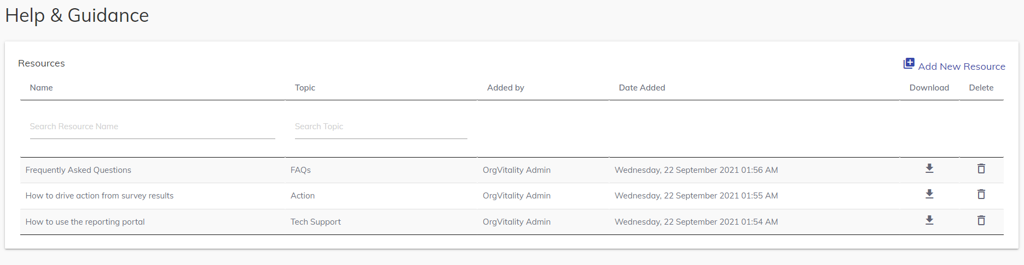
Help & Guidance: Resources
View reporting portal guide by clicking the download arrow.
13

Slide 14
Please find additional pages to substitute in based on client portal specifications
Tool overview Screenshot with the Action Planning Tool listed.
Comments: screenshots without UQ and Sentiment
Action Planning Tool screenshots
©️ 2023 OrgVitality

Slide 15

Main Menu
Overview of Results
Dimensions, Questions, Heatmap, Comment Analysis
Dashboard
Report Library (Pre-Generated Reports)
Manage Reports
Create and Update Action Plans
Action Planning Tool

Slide 16
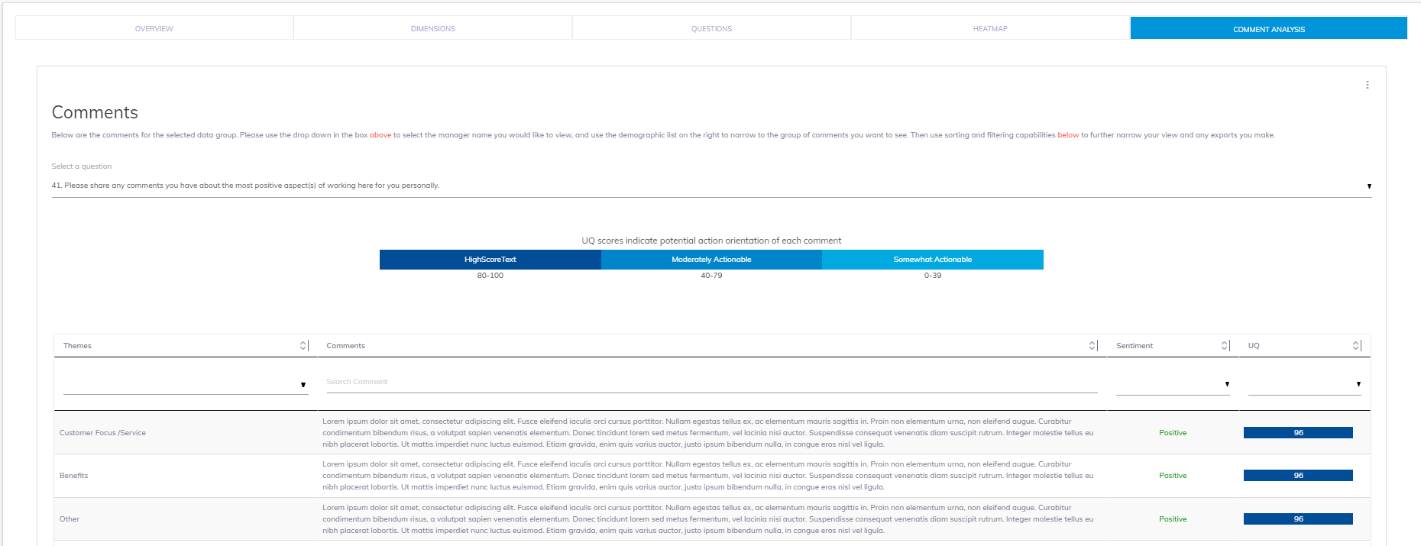
Dashboard- Comments
In this tab you can view all comments, themes, sentiment, and Usability Quotient (UQ).
This tab shows responses to the open-ended survey items. Use the dropdown list to select a question. There is also a dropdown to filter by theme, Sentiment, and/or UQ. Comments can also be exported to Excel.
Note: Click on the top right three vertical dots in any module to download an Excel version.
Use the dropdown to view the open-ended questions and responses.
View and filter by UQ scores. This is a ranking to determine how actionable a comment is. From highly actionable to somewhat actionable.
For questions that allowed for self selected themes use the dropdown to filter by theme.
Search for comment’s here.
View and filter by sentiment.

Slide 17
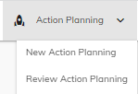
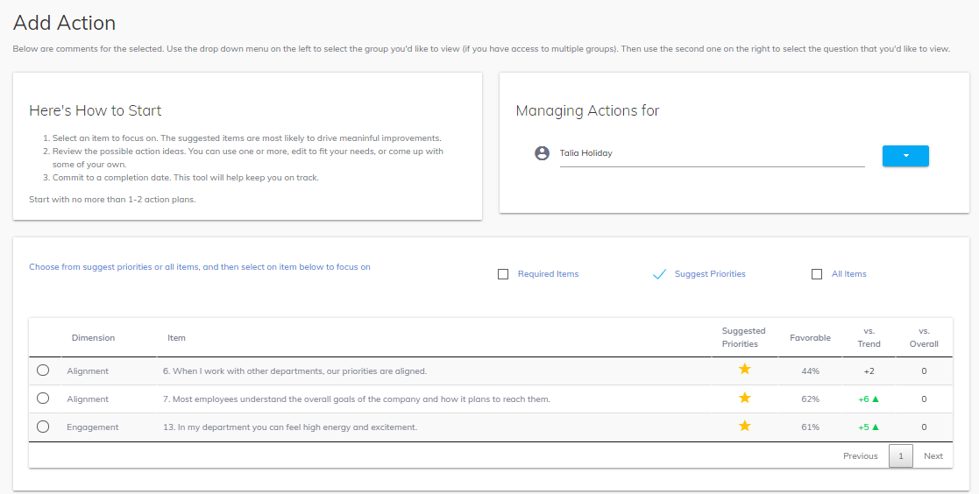
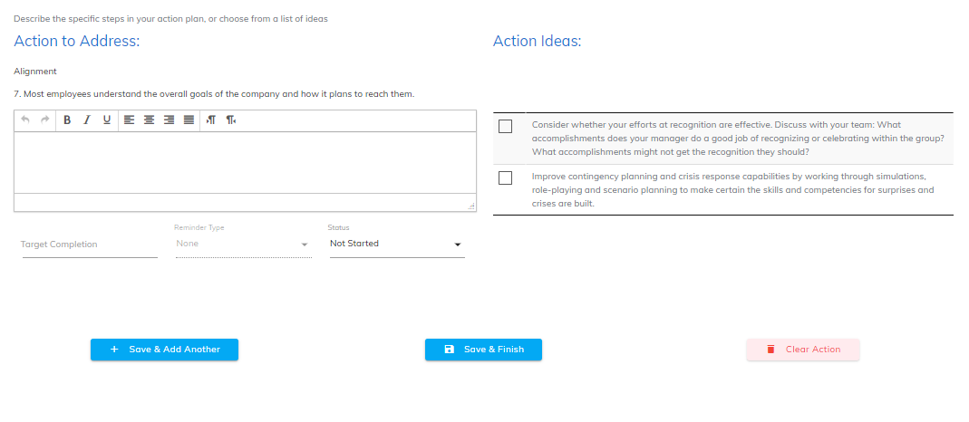
Action Planning- New Action Planning
Create Actions for yourself or others based on access.
Option 1: Choose actions from the Suggested Priorities that are pre-populated.
Option 2: Choose action based on All Survey items. Suggested priority actions will show a star next to them.
Option 3: (**If present) Choose from company wide Required Items.
Once you select an item more options will appear underneath.
A. Action Ideas to choose from/help guide you. If you select one, it will pre-populate in the open text box.
B. Write in and describe your planned actions or add to the Action Idea.
C. Create a Target Completion date by using the calendar pop up.
D. Choose from the Reminder Type options
E. Choose the action plans Status.
F. Click ‘Save and Finish’ or ‘Save and Add Another’ when done.
G. You can also use the ‘Clear Action’ button to start again.
3
1
2
A
B
C
D
E
F
G

Slide 18
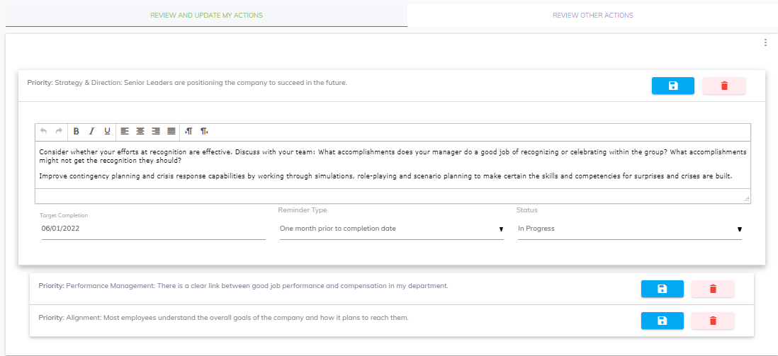
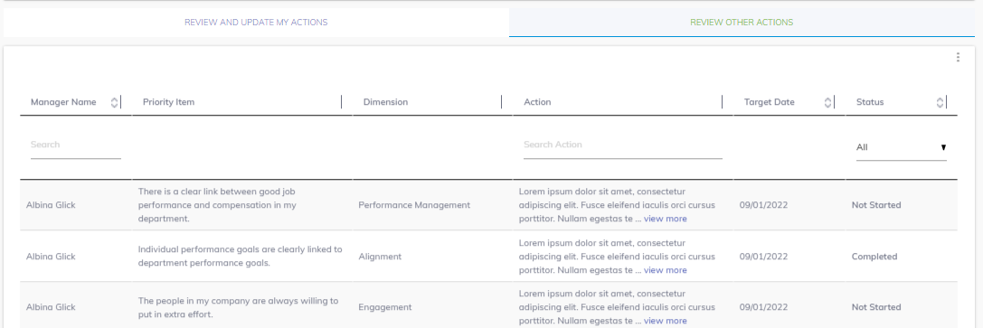
Action Planning- Review Action Planning
Review your action plan or action plans created by someone else, based on access.
Use the tab- Review and Update My Actions. Click on the action boxes to view/update your action plans.
Save new changes/updates.
Delete an action plan.
Use the three vertical dots to ‘Add Action’ or download actions to excel.
Use the tab: Review Other Actions to view others’ action plans you have access to.
Search to find the person whose action plan you want to view.
Sort to view action plans based on the different options.
Use the View More option to view the full action plan.
Export others’ action plans to excel.
1
4
2
3
5
9
7
6
8

